Slide 1
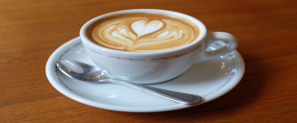
Lucky coffee shop
made by: Gräff Levente – homepage, css, debugging, hungarian presentation Geregely Marci – Coffee page, Blog, Figma Byrappa Arjuna – editing images, english presentation Abousena Adam – cakes, Trello, Figma

Slide 2
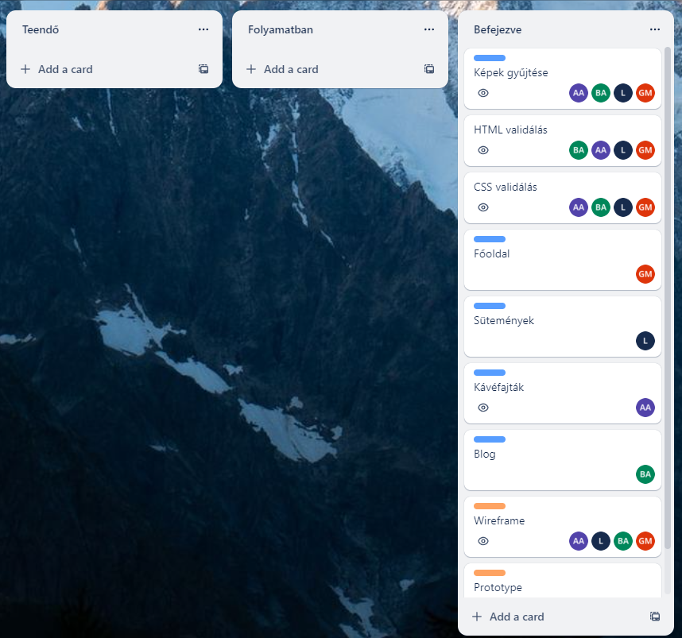
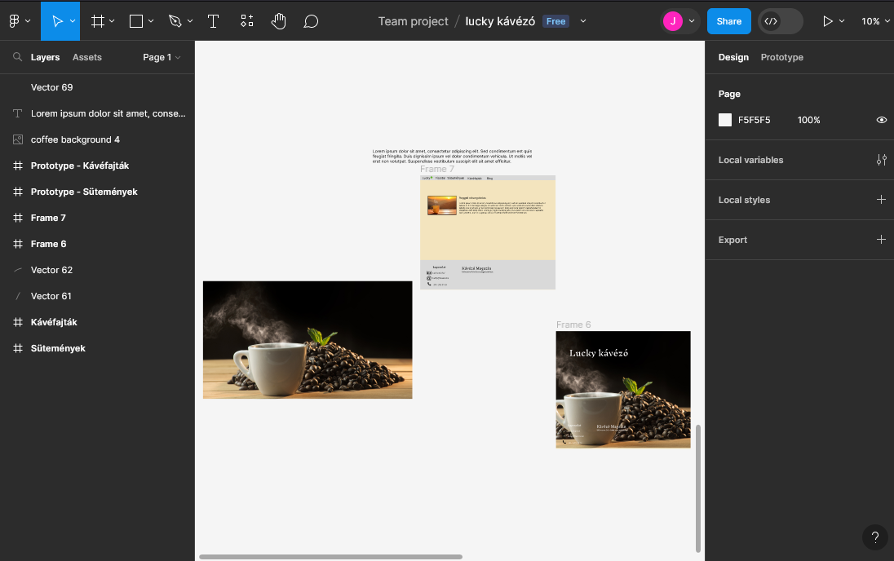
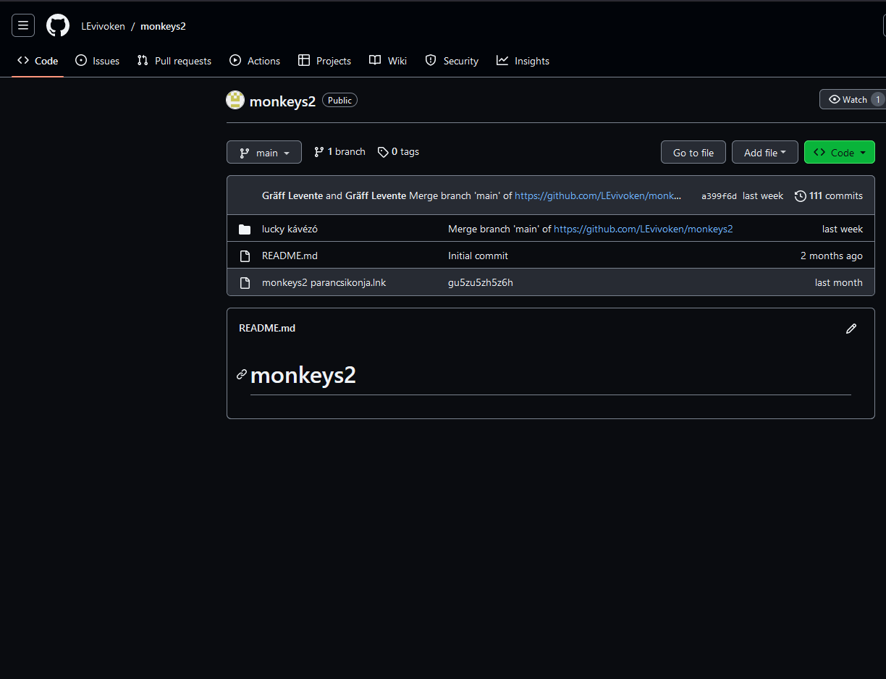
Tools we used
Trello
Figma
Github

Slide 3
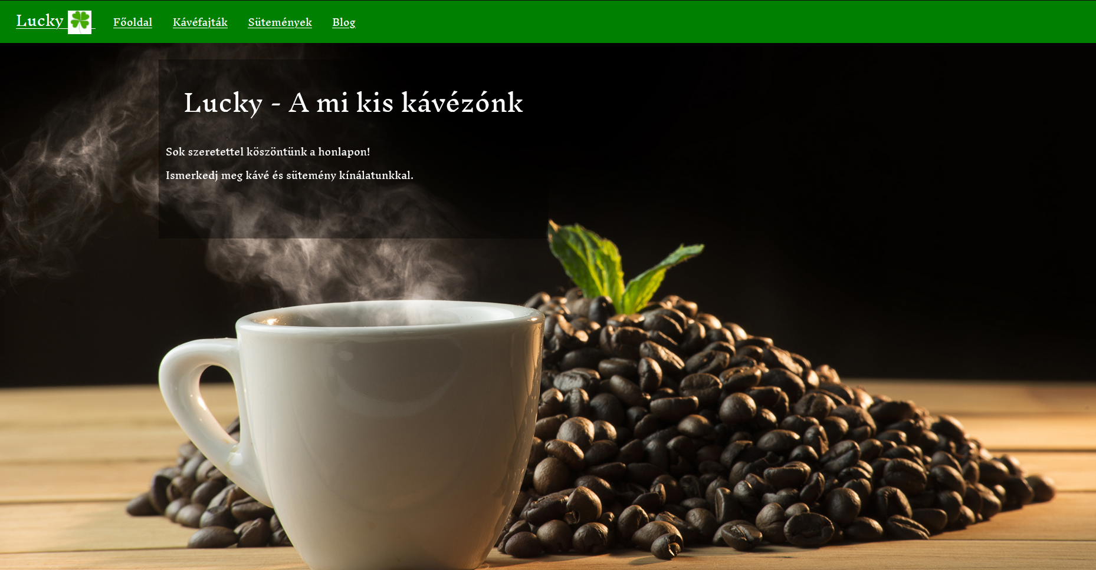
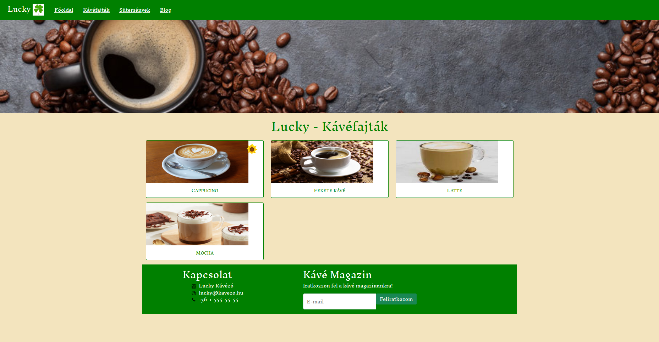
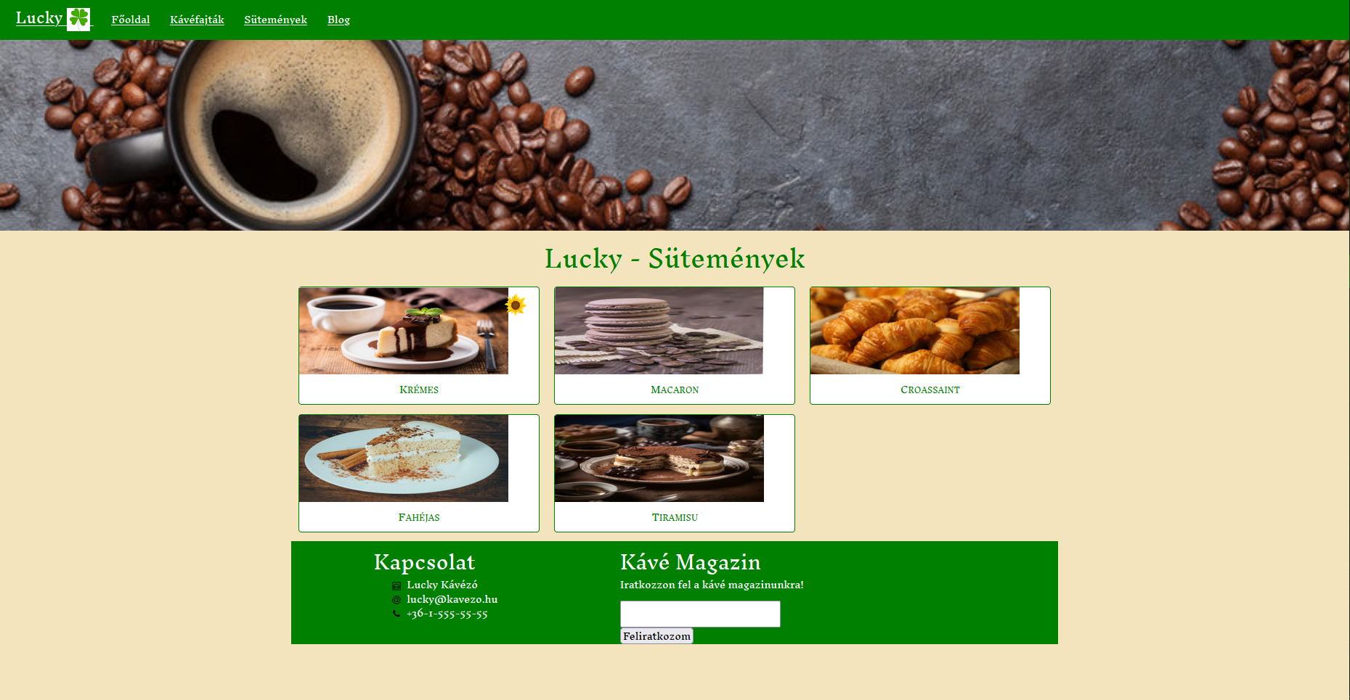
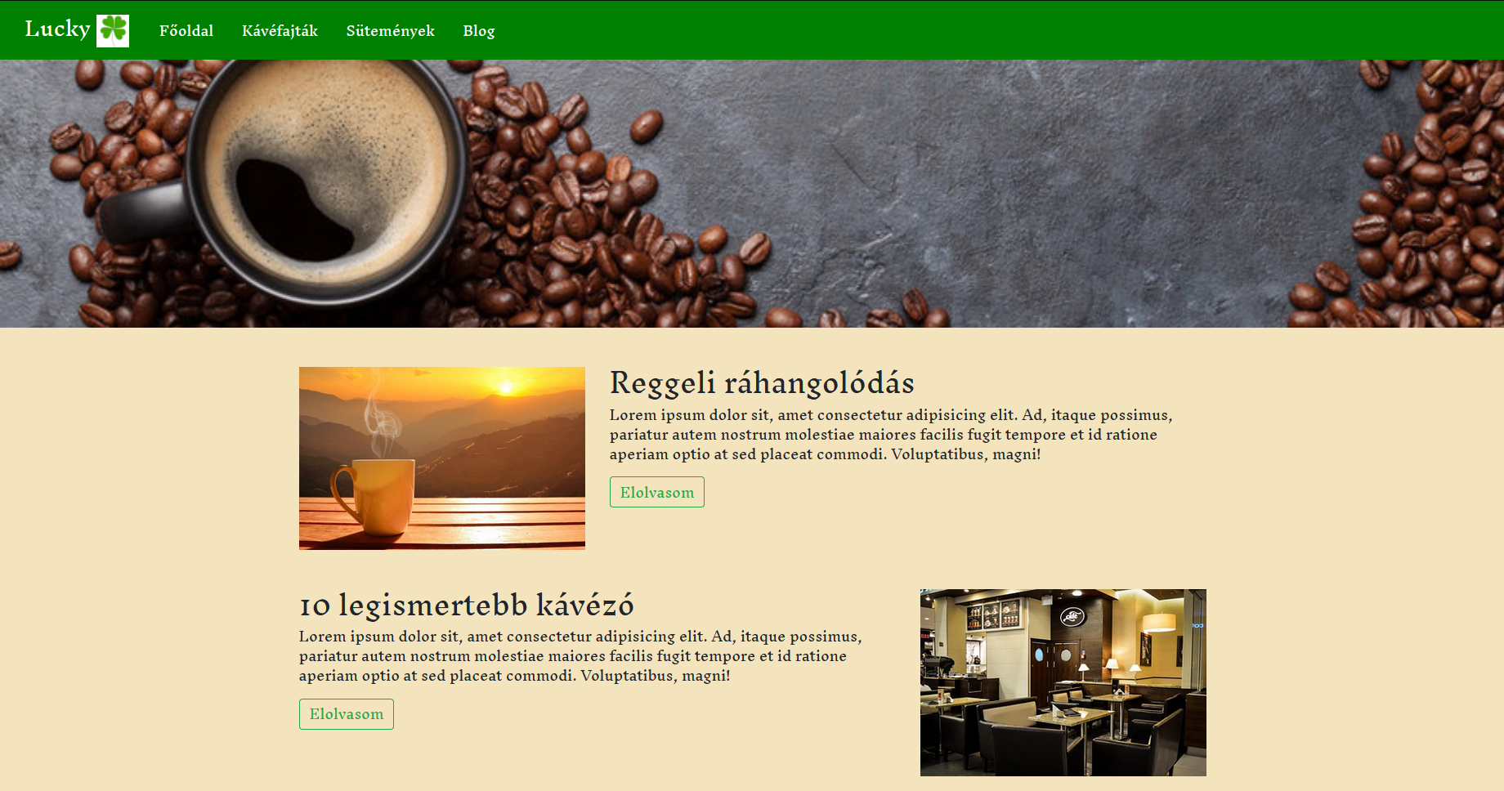

Slide 4
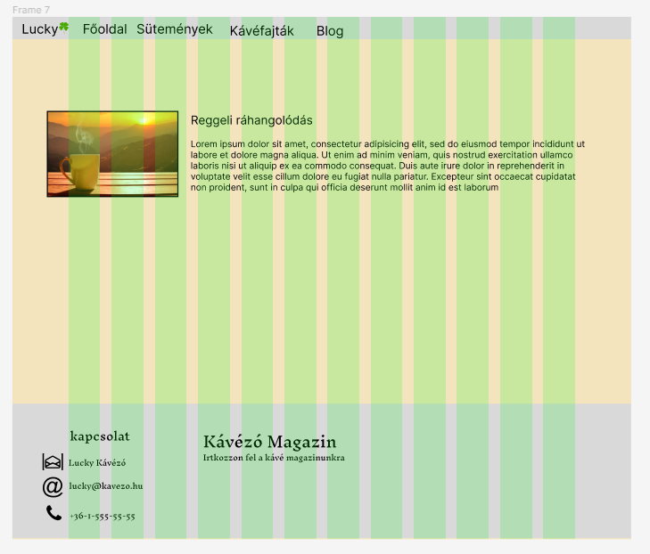
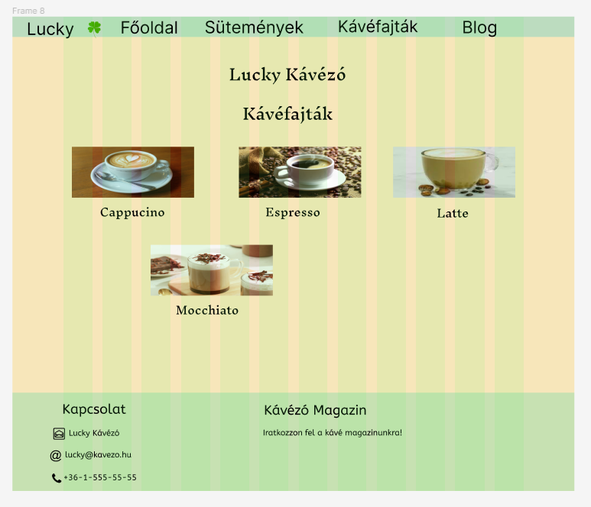
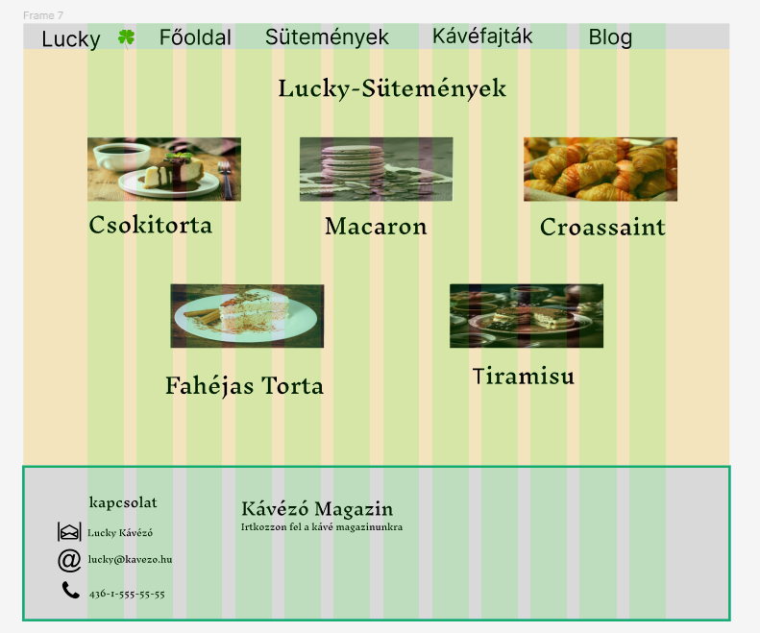

https://github.com/LEvivoken/monkeys2
Prototype/Github link

Slide 5
Thank you for your attention

